Slide 1
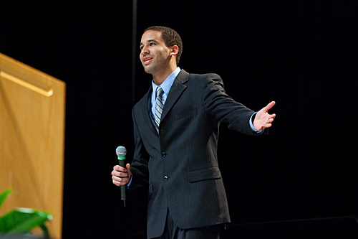
Introducing Speakers
2018-9-12

Slide 2
A good introduction should answer 3 questions
why this speaker,
on this subject,
to this audience?
A little humor is permitted, but an introduction should never denigrate the speaker, even in fun. The idea is to build the speaker up in the audience’s mind.

Slide 3
Introducing Speakers
Preparations
Tips
Introducing
speakers
Before the session starts,
meet speakers beforehand
Some do’s and don’ts when
introducing speakers
How to introduce

Slide 4
What to prepare
Ask the speaker what they’d like you to say.
Many times, the speaker will have an introduction prepared for you. Even if they don’t, they can provide information you can use. When the guest speaker isn’t available, talk to people who know them, such as mutual acquaintances or their coworkers. When the speaker provides an introduction for you, use it. Read it over a few times and be prepared to say it with energy and enthusiasm.
2 Find out what subject the speaker will cover.
Ask around to find out the focus of the speech. The speaker or the event organizers may be able to tell you. This way, you’ll be able to hone your speech so it introduces the speaker's topic. Your introduction needs to relay exactly what the audience can expect to hear.

Slide 5
For more credibility
3. Look up biographical information on the speaker.
4. Avoid using sensitive or embarrassing information without approval.
5. Find other speeches the speaker has given.
Include a surprising detail if it fits in your intro.
7 Master pronouncing the speaker’s name.
8 Check for any special titles the speaker has.

Slide 6
Some do's and don’ts while introducing speakers
1
3
The introduction should not last longer than three minutes or some two hundred words
Introduce the speakers in a comfortable and professional manner
Don’t make
the remarks
too effusive
or hyperbolic

Slide 7
Procedure
1. Introduce yourself when you begin. Stating your name and title is useful if someone in the room is unfamiliar with you. Keep this line short so you can get to the rest of the introduction. “Good evening. My name is Alex Brown and I’m the organizer of this event.”
2. Show enthusiasm while speaking. Because you practiced, you'll be ready to recite the introduction with enthusiasm. Keep the energy level high. Stand up straight. Increase the energy level as you build towards the introduction by producing a little more volume and authority.
3. Speak loudly and clearly. Many speakers get nervous or overexcited. They rush their speech, sounding inaudible. Slow yourself down. This ensures every part of your introduction is audible in the audience. You’ll notice that each word stands out and you can project to the back of the room.

Slide 8
4. Lead the applause. When you get to the end, stand in place. State your final line with force. Be the first person to offer applause. As the introducer, you are setting the stage for the guest speaker. The audience will follow your lead, and nothing’s worse for the speaker than languid applause.
5. Orient yourself towards the speakers as they approach. Turn your body to them. Your feet should point at them and your eyes should meet theirs. Give the guest speaker a big, authentic smile. Stay in place and continue to applaud until they reach you.
6. Shake the speaker’s hand. Shaking hands is a positive gesture. The audience will notice it. It’s a humanizing greeting that shows a bond between you and the speaker. Continue to face the speaker until they reach you on stage. Shake their hand and then walk confidently off stage.

Slide 9
Other details
7
8
9
10
Help
the speakers handle the facilities if they have problems
Adhere closely to time requirements that have been established
Thank to the speakers before you invite questions for him or invite the next speaker
Should never fiddle, talk or look around the hall

Slide 10
How to introduce
Academic achievements
Speech experiences
Awards and honors
1.…….wrote extensively on the issues of ……
2.Our speaker is the author of the upcoming book…….and has ……. on work.
3.As an author he/she has published……. Including …….
1.Our speaker has had fellowships and grants from ……
2.He/she has earned the title of…….—the highest honor given by …… only ……members have been so honored
Samples：
1.Today’s speaker has appeared on …….
2.He/she is a frequent keynote speaker at national , regional and state conferences in …….
3.As one of the country’s leading…… experts, he/she is a sought-after speaker who has addressed associations across the country , including ……

Slide 11
How to introduce
Topic
structure
Welcome remarks
1.We will hear first from……, followed by…..
2.Our first speaker will be ….., the next speaker will be …..
1.Ladies and gentlemen , please join me in welcoming……
2.Please help me give a dynamite welcome to …….
3.I’d like to extend a warm welcome to……
4.I’m glad to present to you ……
Samples：
1.The topic of today’s presentation is ……
2.Today’s presentation is called……
3.Please join me in welcoming ……, whose topic is ……
4.Let me present to you ……., who will speak on……

Slide 12
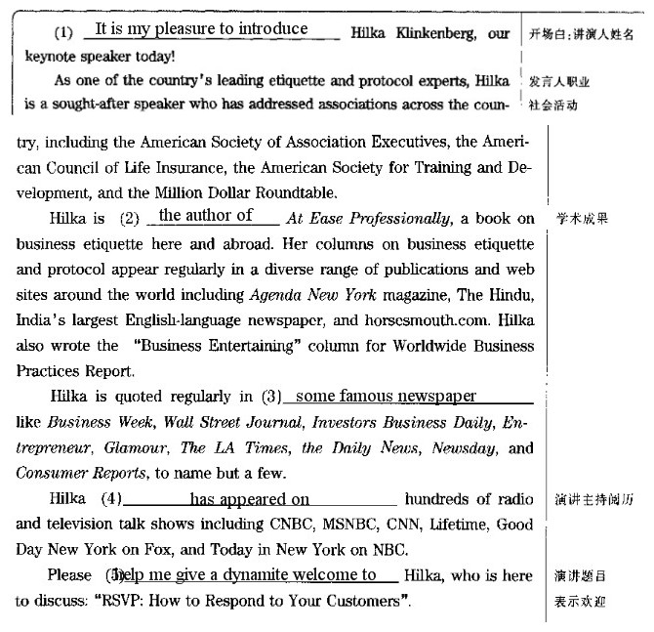

Slide 13
谢 谢
研究生公共外语教学部
2018秋

